Slide 1
ExploreAtlas:
Your Guide to Uncharted Adventures

Slide 2
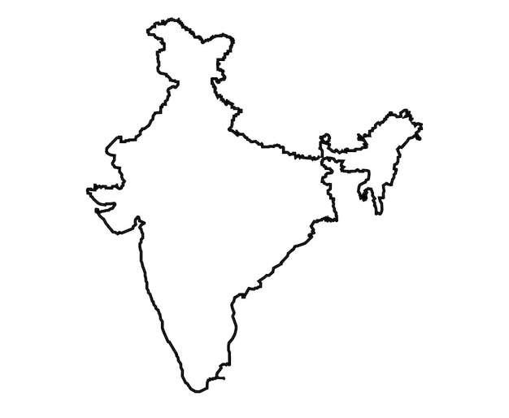

Introduction
ExploreAtlas is your ultimate guide to discover and helping others discover the world’s most captivating destinations
Viewpoints
Camping Spots
Trekking Routes
Any such terrains
LOCATION you add is reflected as CHECKPOINTS on the MAP

Slide 3

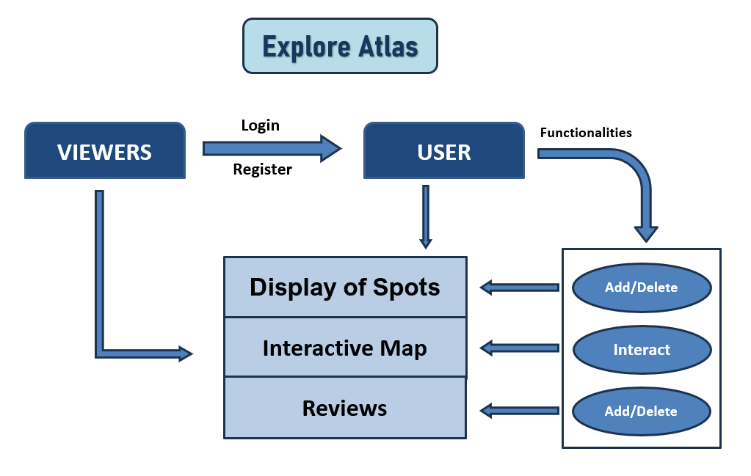
FLOW of the APPLICATION
Go, change the world
RV College of
Engineering

Slide 4




TECH STACK
Go, change the world
RV College of
Engineering

Slide 5



SERVICES/APIs
Go, change the world
RV College of
Engineering
CLOUD
To store IMAGES of the Spots
MongoDB Atlas
Handles all the complexity of deploying and managing
MongoDB deployments on cloud
MAPS
APIs that provide interactive maps to mark the locations

Slide 6
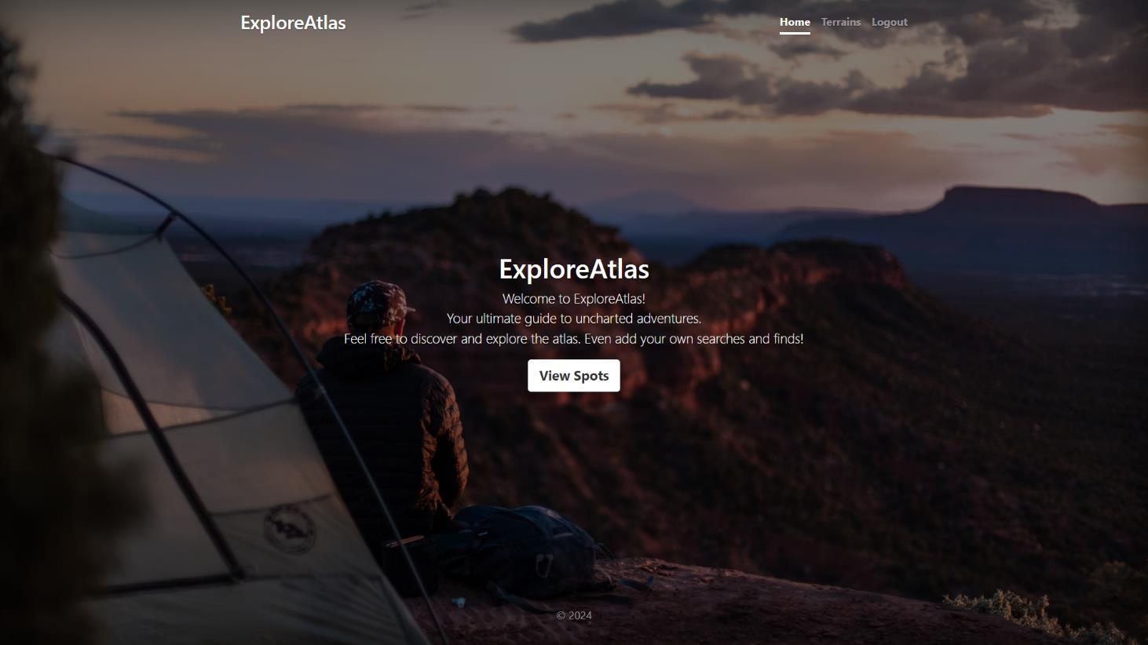
HOME PAGE
Go, change the world
RV College of
Engineering

Slide 7
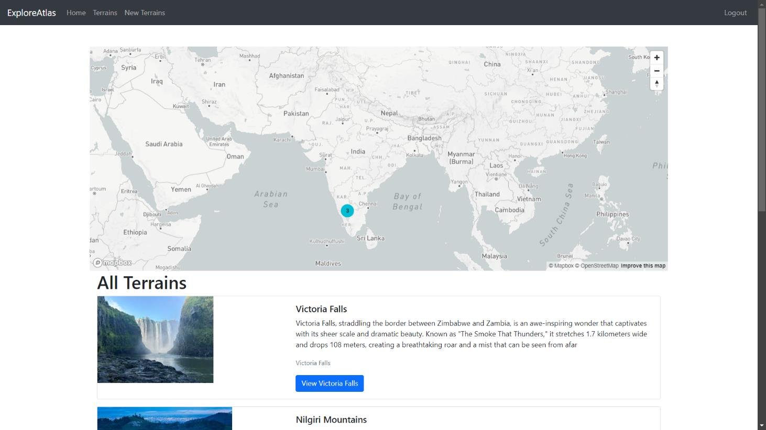
INTERACTIVE MAPS
Go, change the world
RV College of
Engineering

Slide 8
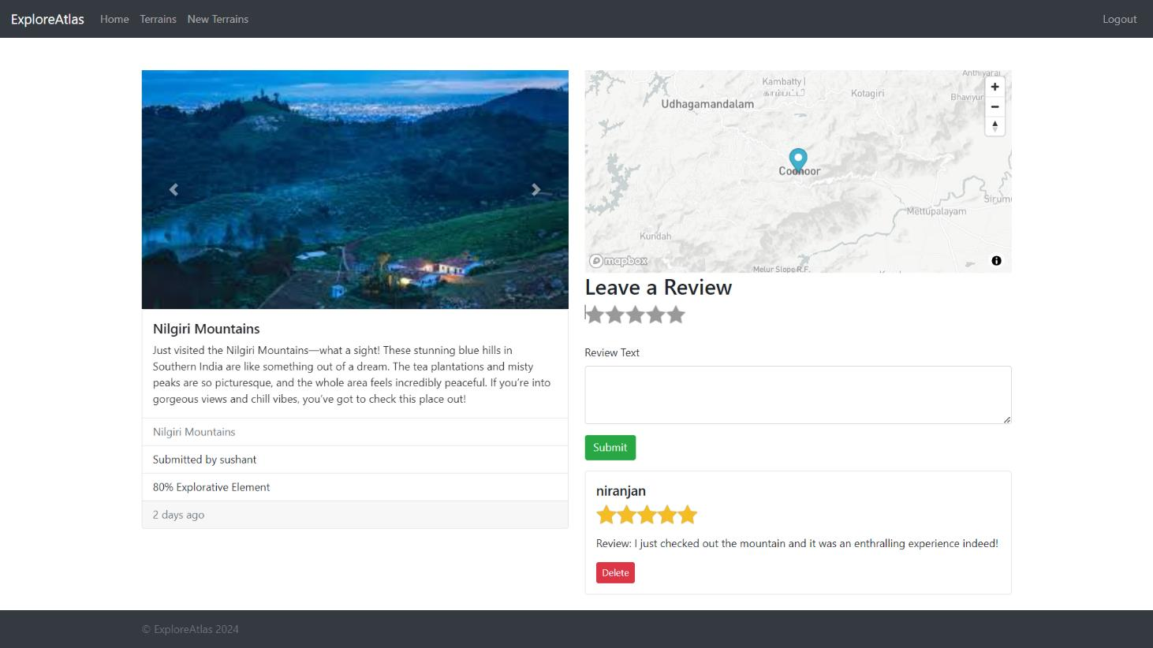
DISPLAY OF SPOTS
Go, change the world
RV College of
Engineering

Slide 9
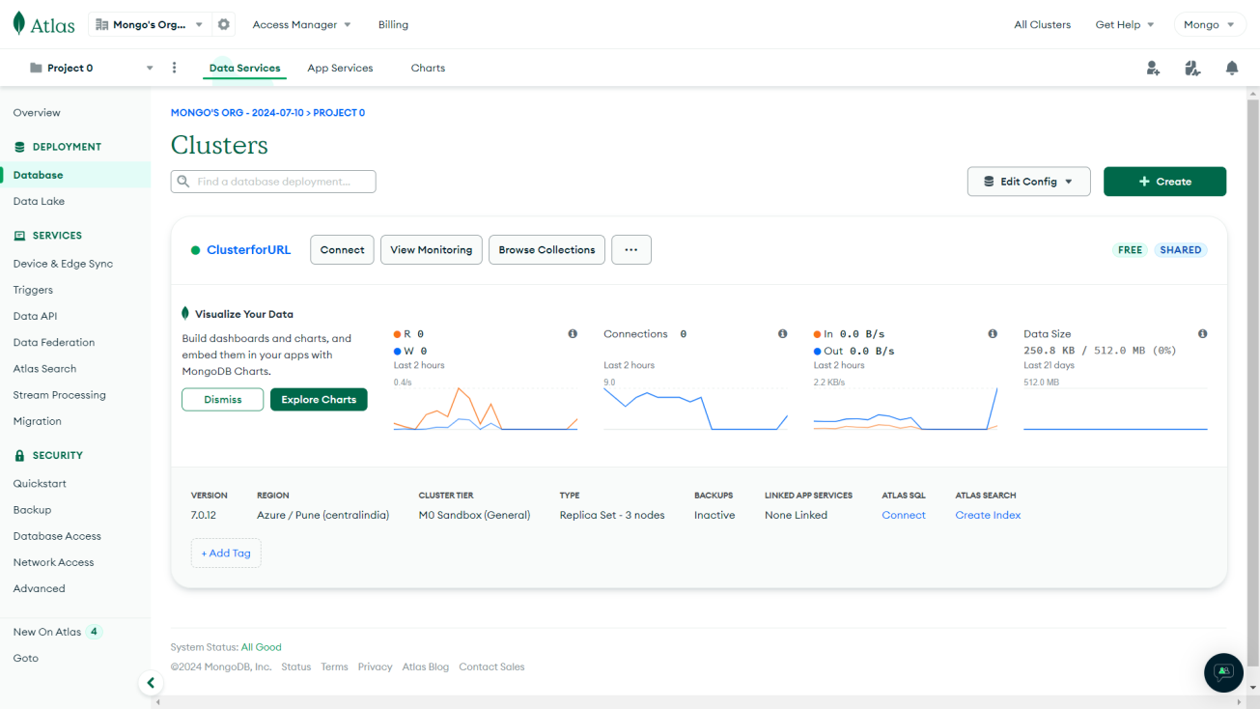
MONGODB
Go, change the world
RV College of
Engineering

Slide 10
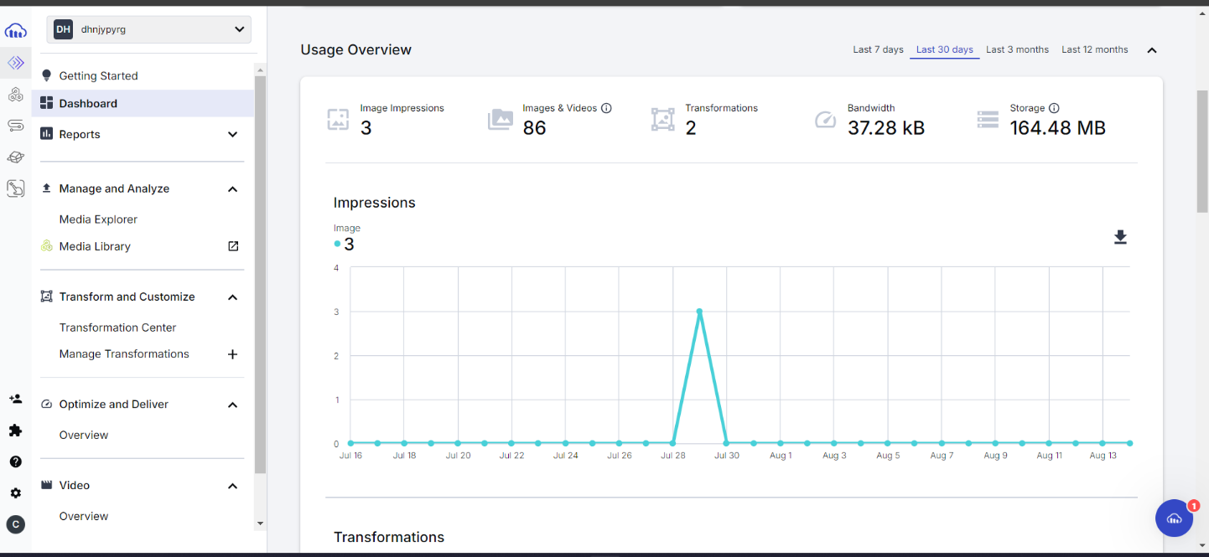
CLOUDINARY
Go, change the world
RV College of
Engineering

Slide 11
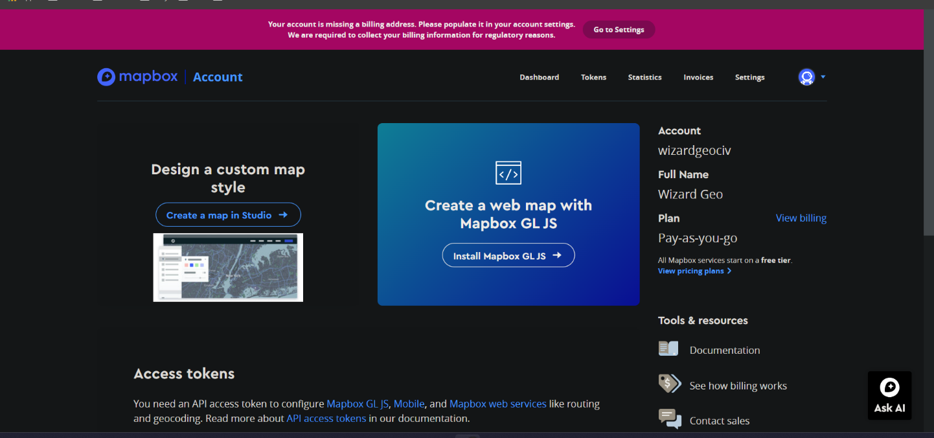
MAPBOX
Go, change the world
RV College of
Engineering

Slide 12
ARCHITECTURE
Go, change the world
RV College of
Engineering
User login or register
Display of spots as a LIST as well on the interactive MAP
Users can ADD - Location and Photos of a new spot
Users can Review and Comment on the location

Slide 13
Thank You
Go, change the world
RV College of
Engineering

